Slide 1
Seam Carving for Content-Aware Image Resizing

Slide 2
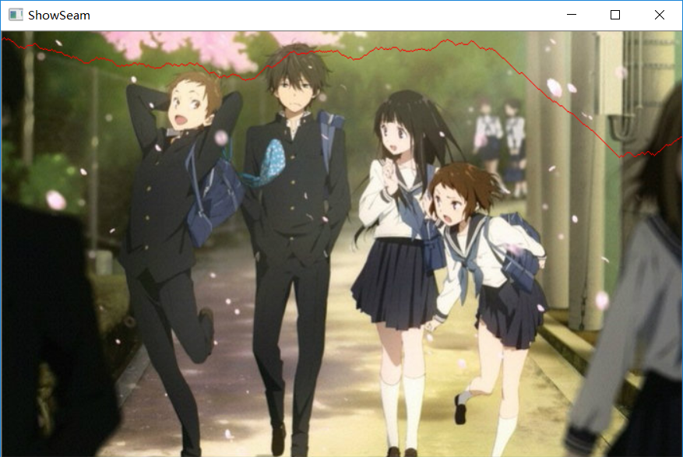
How to resize a picture without distorting content?

Slide 3

How to resize a picture without distorting content?

Slide 4
How to define a seam?
1. Minimum Energy Cost : the least apparent pixels
2. 8-connected path

Slide 5
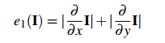
How to define Energy for pixels
Energy = Saliency
I use the simplist Energy Function—— E1
Get an Energy Map (a float matrix)

Slide 6
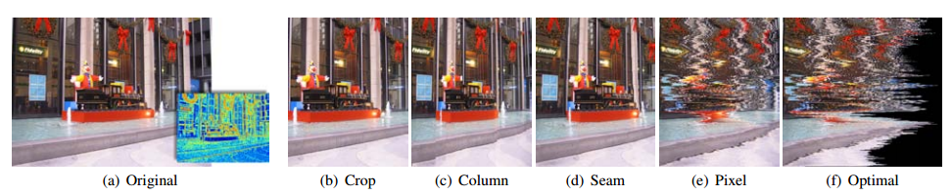
Why Choose an 8-connected Path?

Slide 7
How to find this 8-connected Path?
-动态规划算法
-注意保留traceMap 进行轨迹回溯

Slide 8
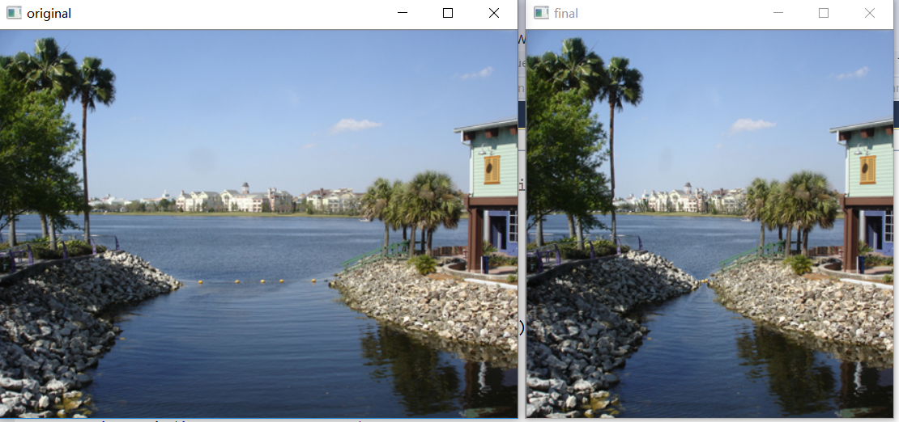

Slide 9
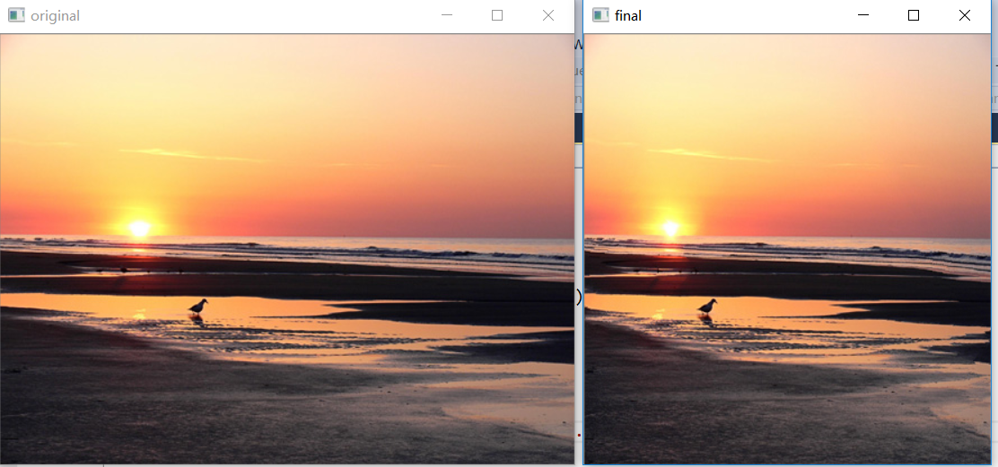

Slide 10
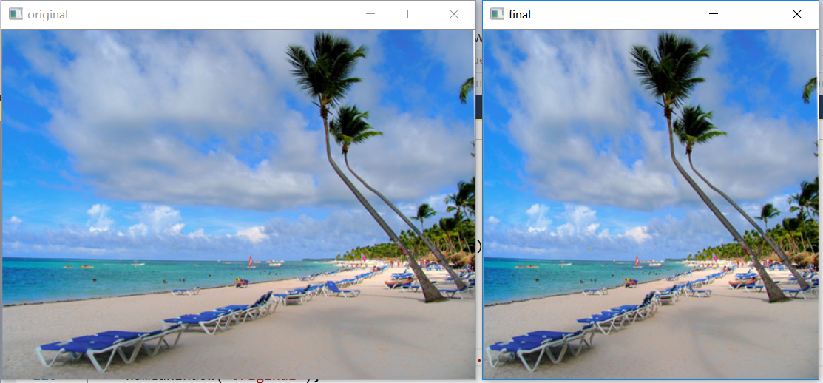

Slide 11
